Slide 1

INTO CI/CD
ABCD
Achieve,
Build,
Cloud-Based Software Automation and,
Deployment.

Slide 2
CI/CD
CI: CI stands for continuous integration. It ensures that the team of developers securely merge their code efficiently into a mainline to ensure high quality and awesome business standards.
CD: CD stands for continuous delivery. It helps us automate deployments of code for efficient Time-to-Market and to beat the competition
CD: CD also stands for Continuous Delivery. This ensures our product get delivered to production continuously keeping our customers happy and the money flowing in.

Slide 3

WHY WE NEED CICD
Quickly catch errors and reduce deploy to production time
Reduces downtimes costs and the costs that comes with human errors and improves deployment time
Automation of tests such as smoke test helps reduces downtime and financial losses

Slide 4
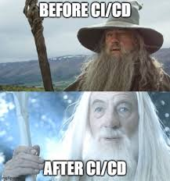
WHY WE NEED CICD
Manager will receive products and deliverables faster than the competition
Cloud infrastructure and services costs will be better supervised and managed more efficiently

Slide 5

Thank You

